Slide 1
Hotel Booking Application
CMPE 202 - Project
Akansha Rawat
Karishma Kuria
Nisha Mohan Devadiga
Weifeng Ma

Slide 2
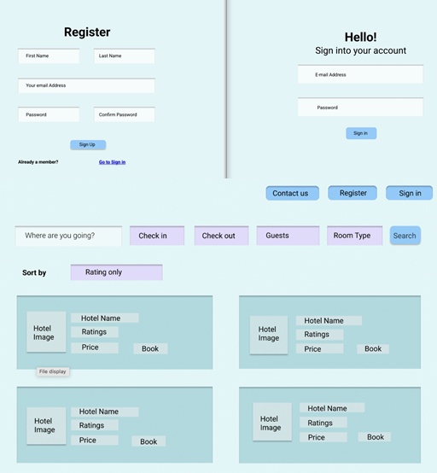
Introduction

Slide 3
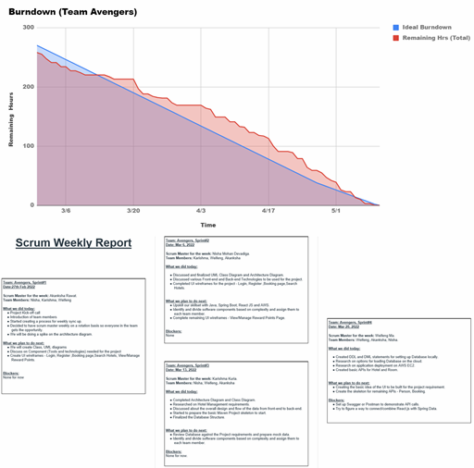
XP
XP values
Weekly Scrum
Burndown chart

Slide 4
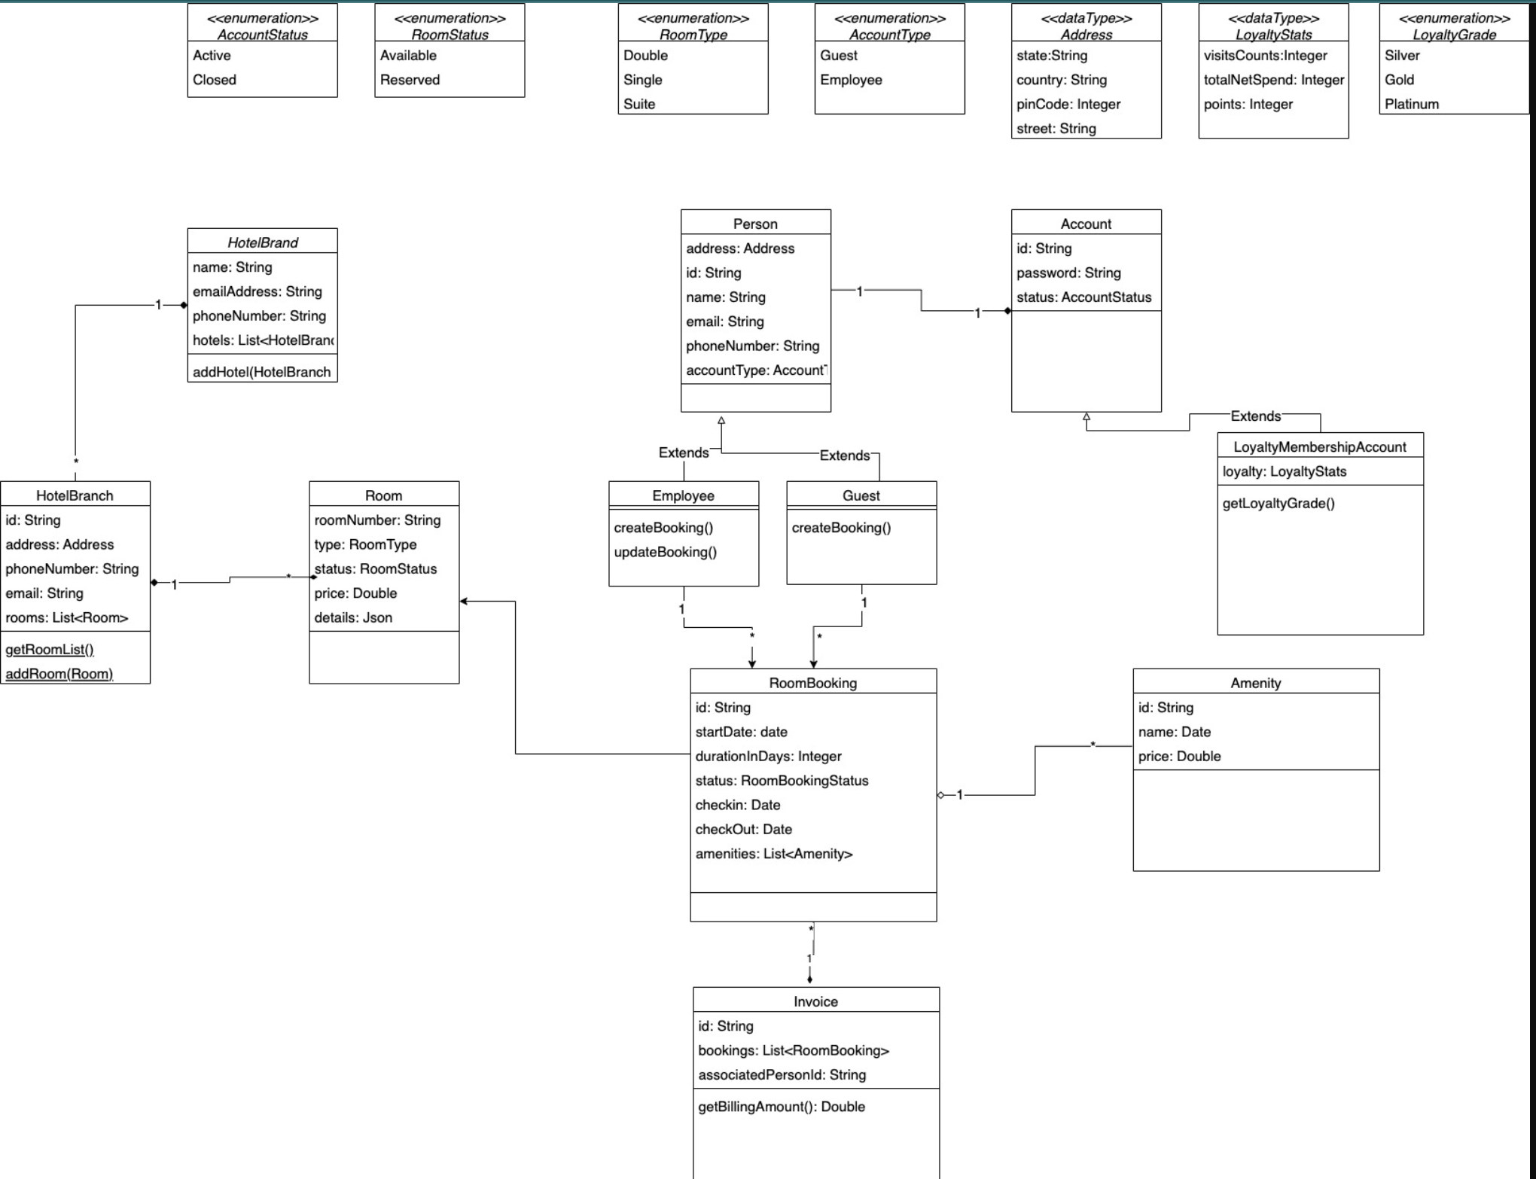
Class diagram

Slide 5
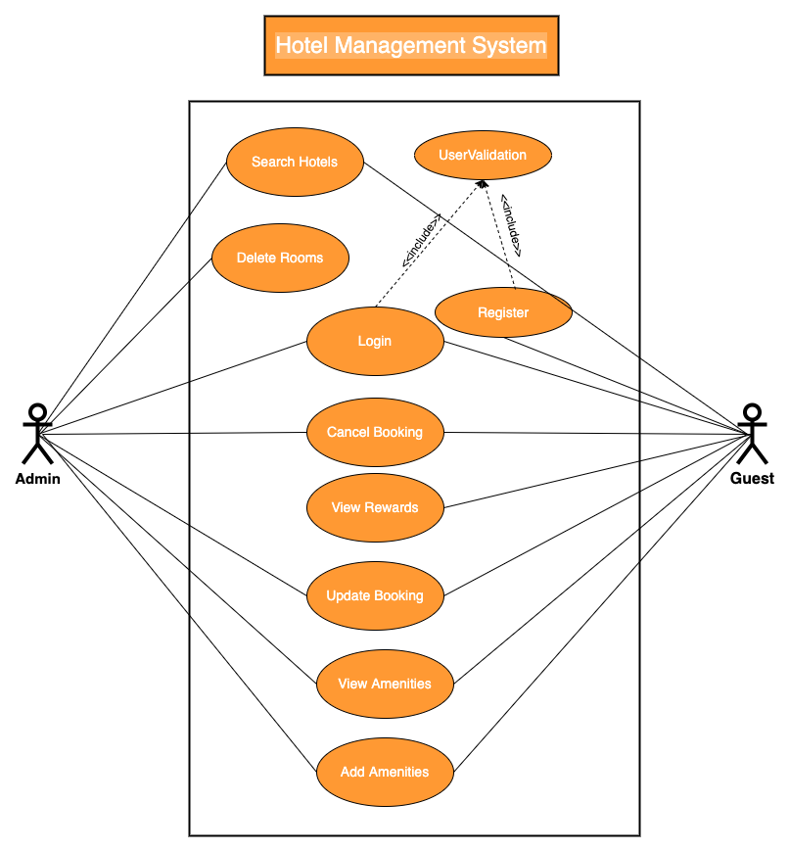
Use Case Diagram
2 types of Users:-
Admin
Performs:
Search Hotel
Delete Rooms
View/Cancel Booking
View Amenities
Update Booking
Add Amenities
Guest
Performs:
Search Hotel
View / Manage Reward Points
View/Cancel Booking
View Amenities
Update Booking
Make Payments
Notes:
Use Case Diagram:
2 types of Users - Admin and Guest

Slide 6
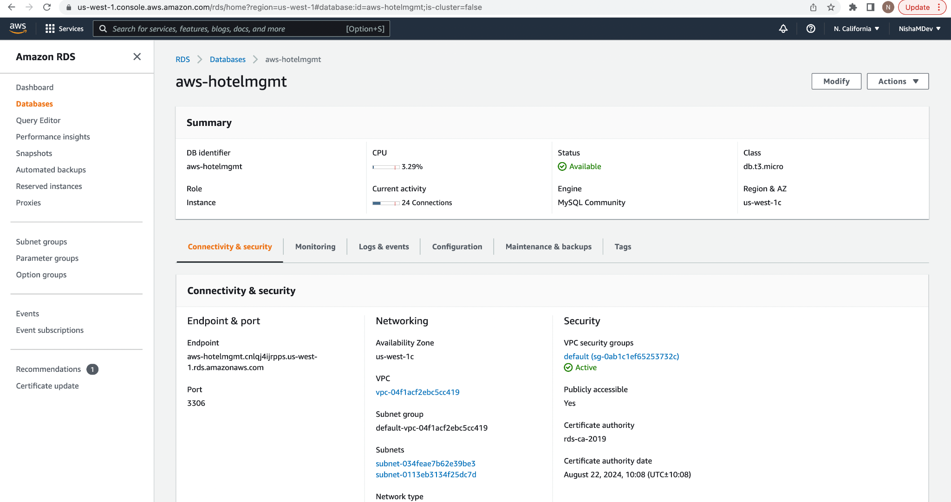
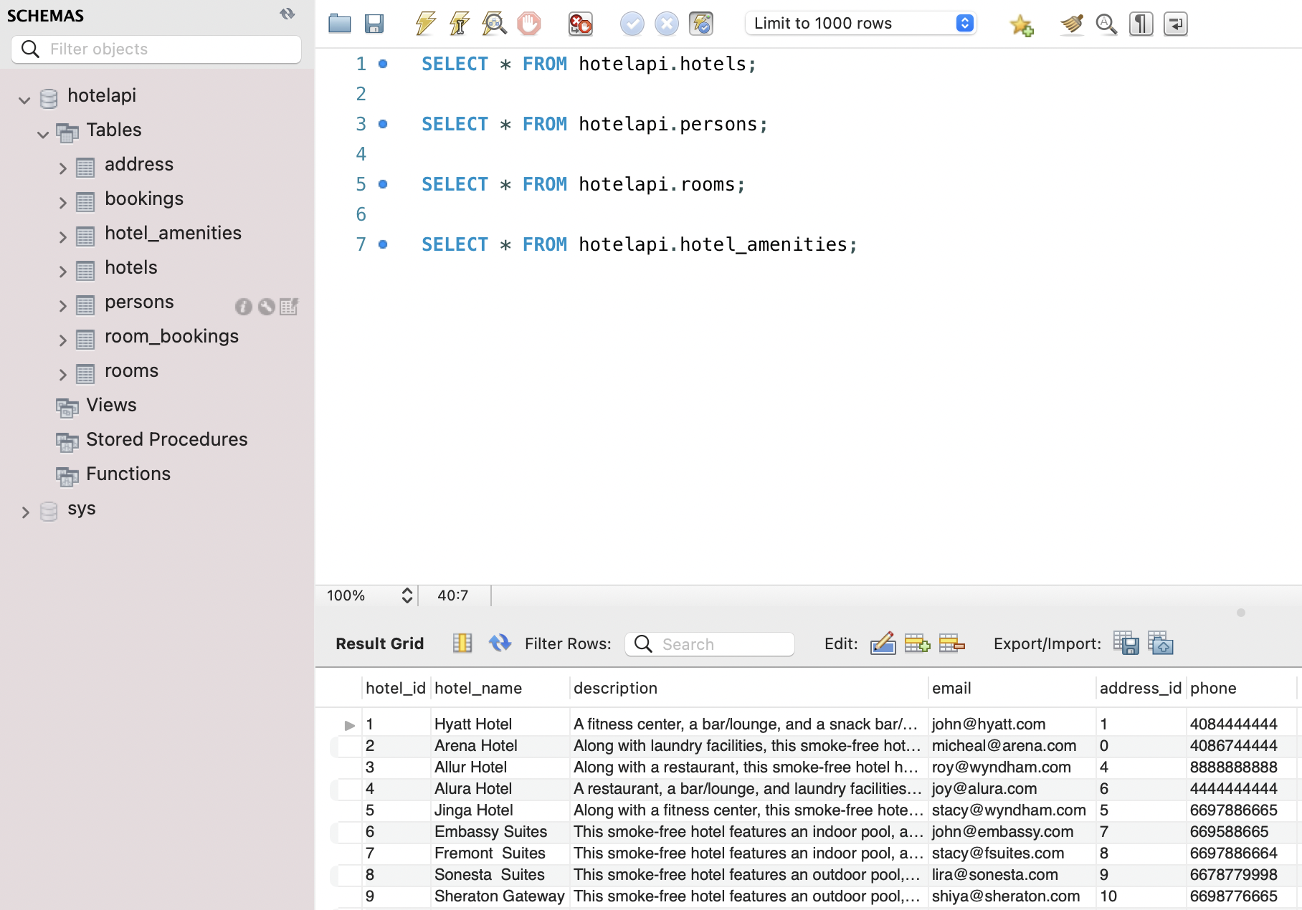
Database
Deployment on AWS RDS →
Database Schema(shown below)

Slide 7
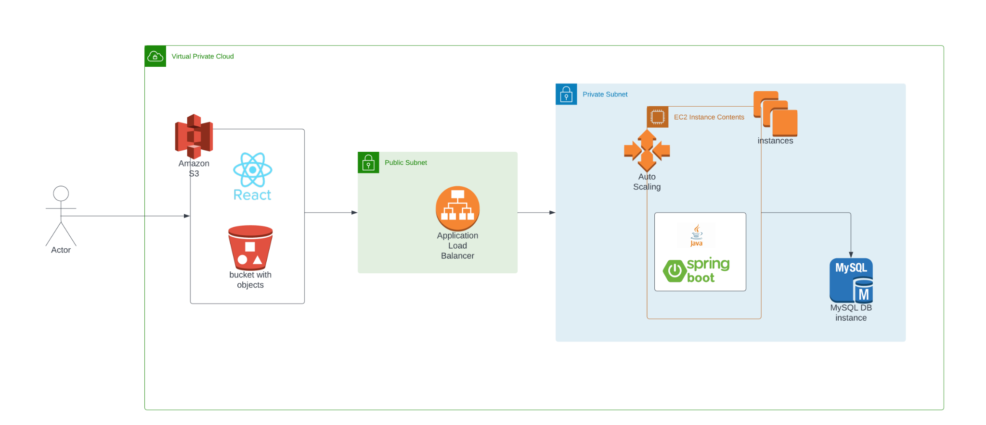
Architecture
Notes:
Cloud provider - AWS.
Frontend - React JS, Material UI for UI components, Frontend build using AWS Amplify, deployed into AWS S3.
Recoil for state management
AWS cognito - for authentication
AWS cloud formation to deploy AWS Amplify and AWS cognito.
Backend - Java SpringBoot framework , Backed Build using Github actions, deployed into AWS EC2 cluster.
Database - MySQL deployed on AWS RDS.
API Documentation - Swagger.

Slide 8
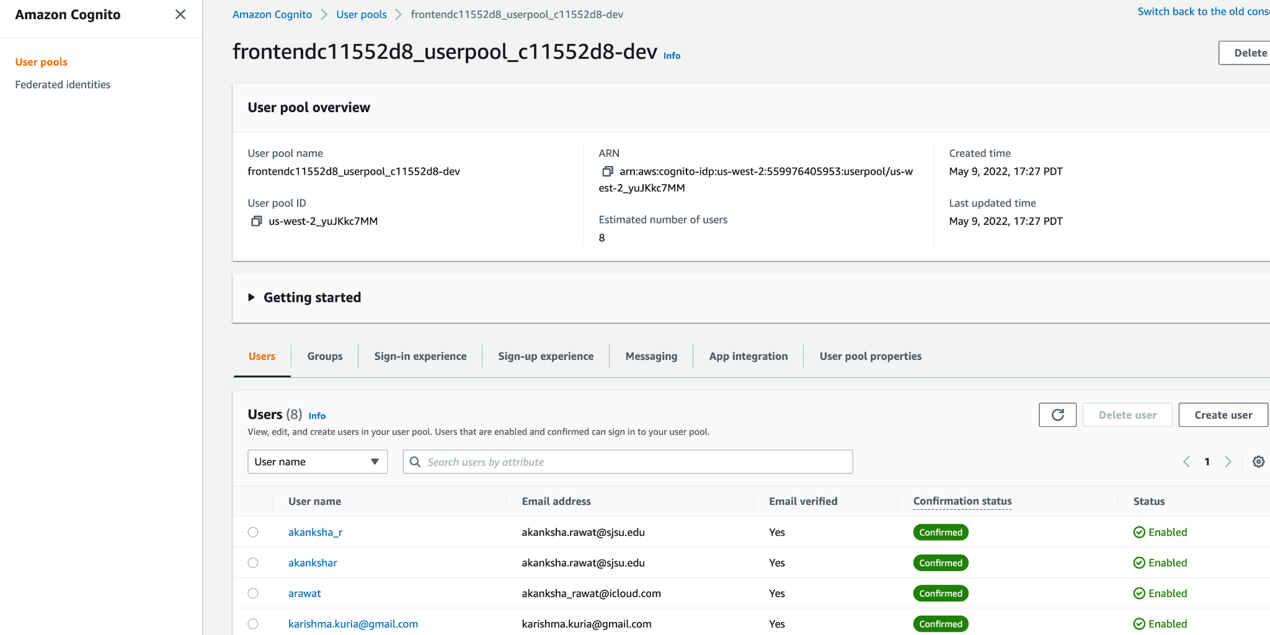
Authentication: AWS Cognito

Slide 9
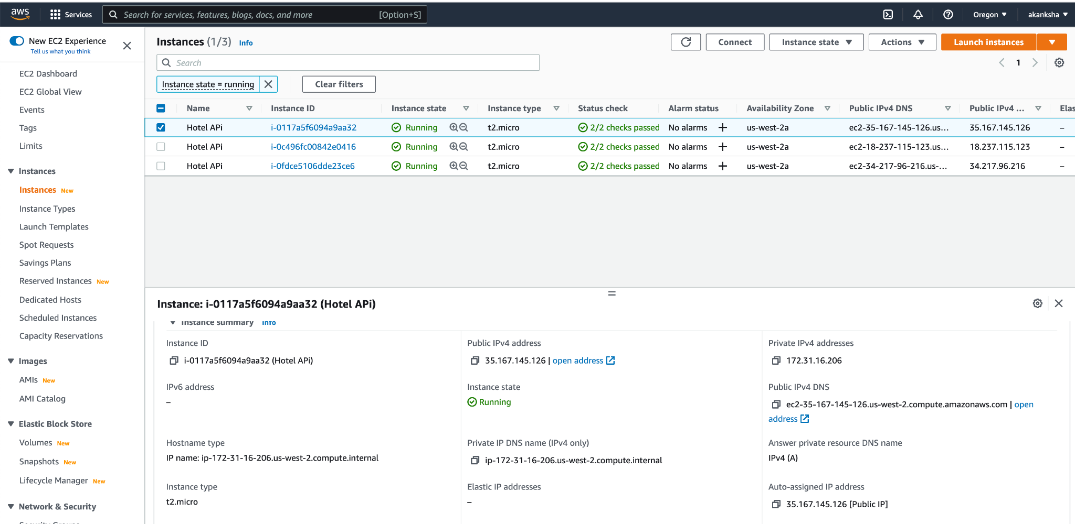
Backend on AWS EC2

Slide 10
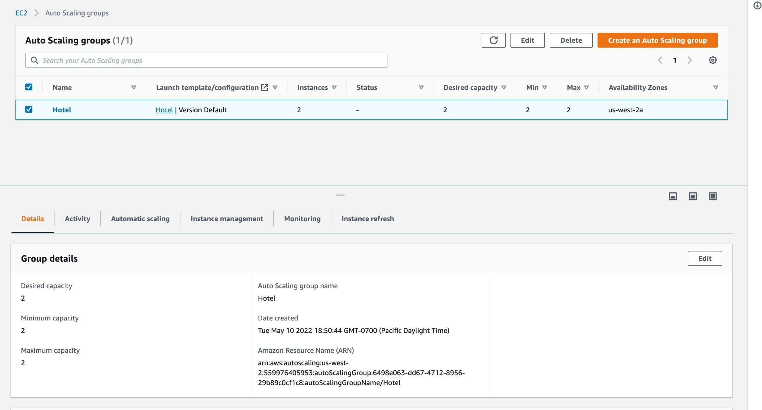
Auto Scaling group

Slide 11
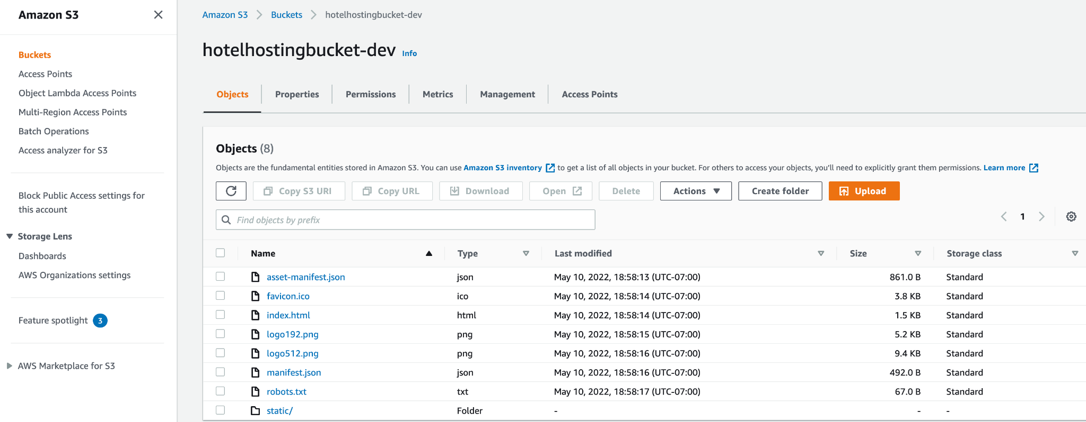
Frontend deployment- AWS S3

Slide 12
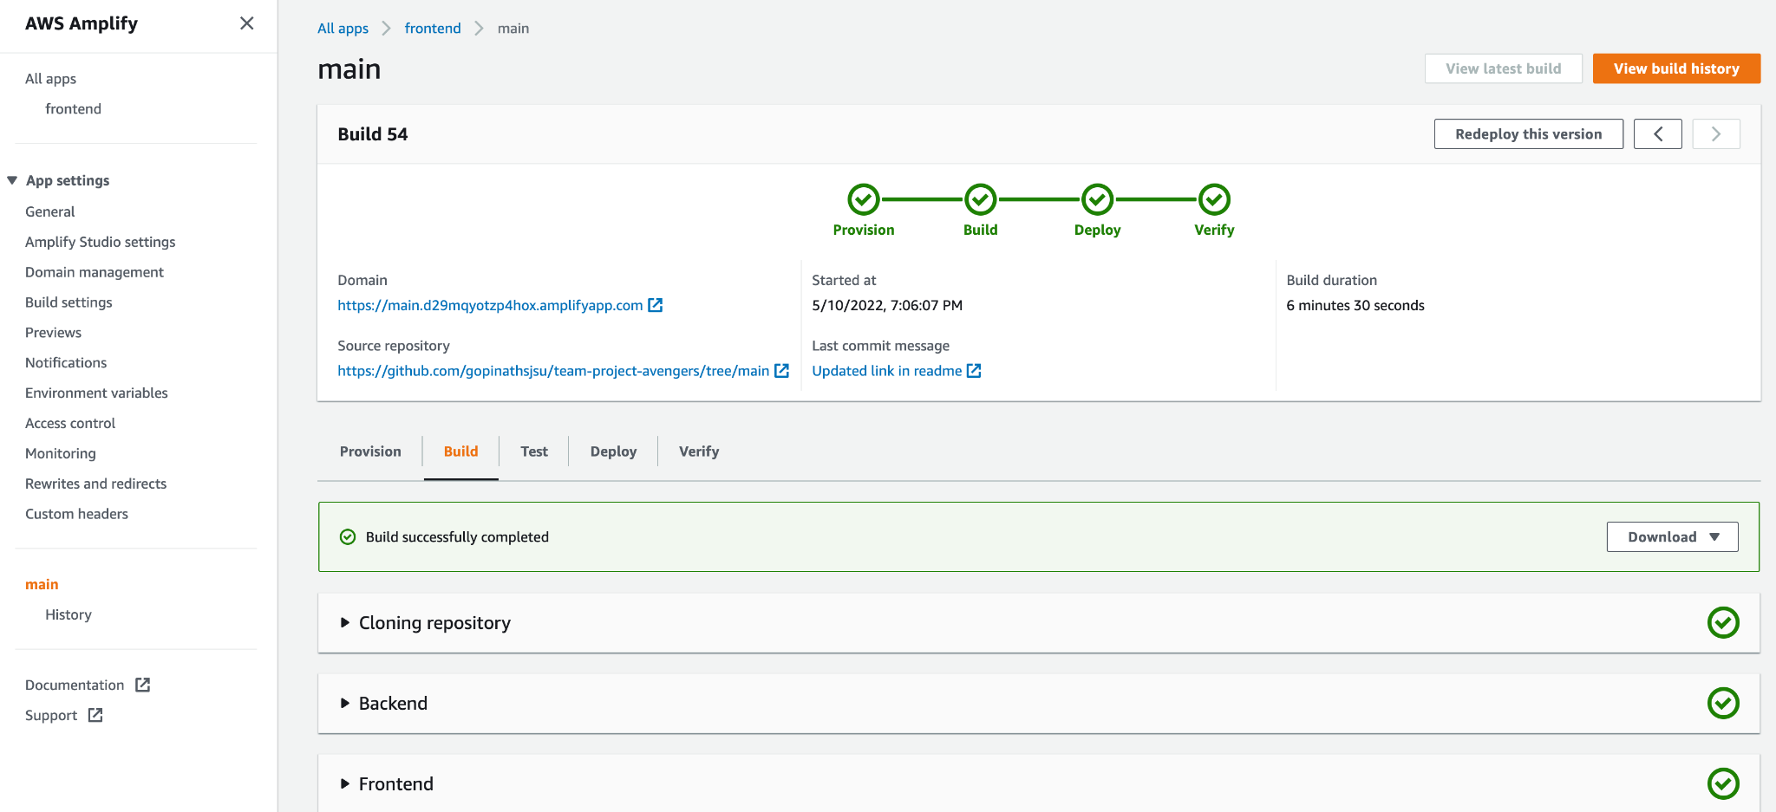
FrontEnd Build- AWS Amplify

Slide 13
Demo
Backend Deployed : http://ec2-35-167-145-126.us-west-2.compute.amazonaws.com:8080/swagger-ui.html#/
Frontend Deployed: http://hotelhostingbucket-dev.s3-website-us-west-2.amazonaws.com/
Paypal test cred-
sb-hds7h13788723@personal.example.com
#C93z_nm - password

Slide 14
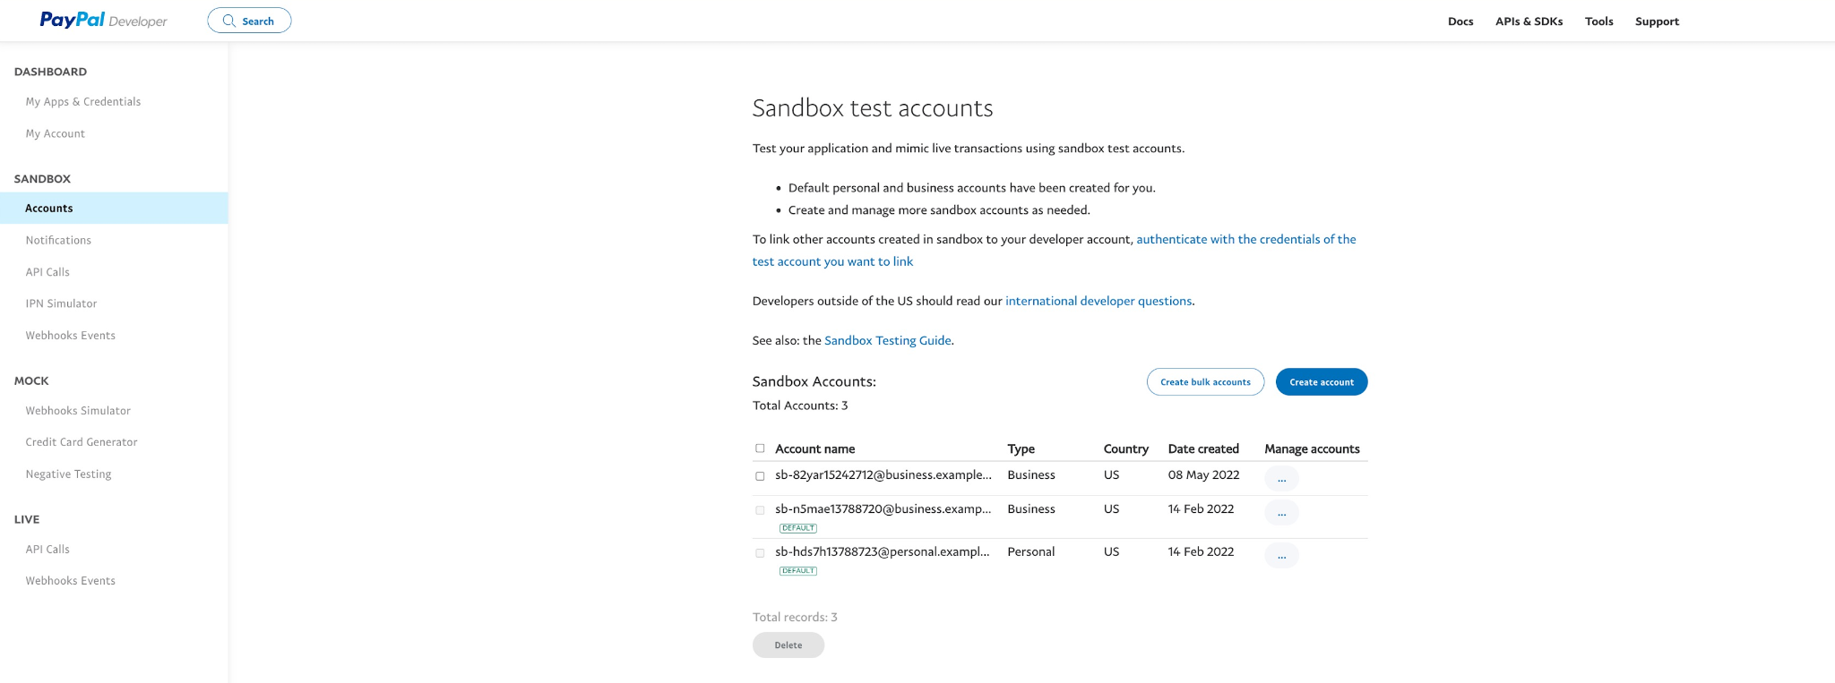
Paypal test account

Slide 15
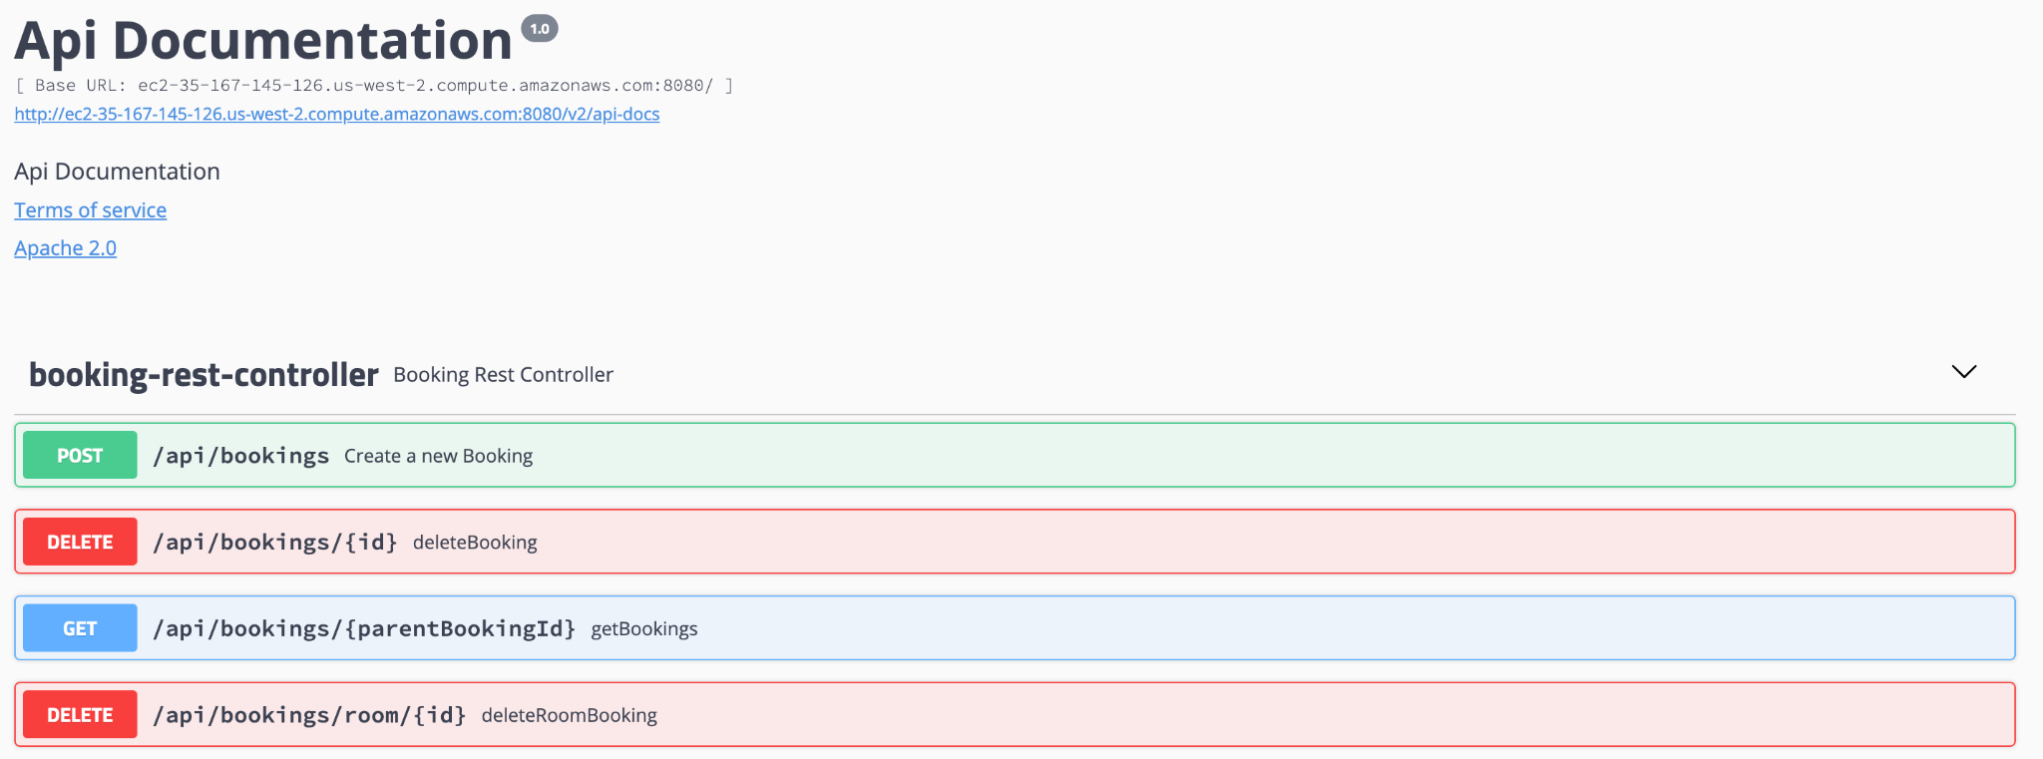
API Testing

Slide 16
Appendix

